Slide 1


Groundwork:
AI Readiness Diagnostics
NELLY POURMEHR, BRAINYFUTURE AI CONSULTING

Slide 2

The Problem
UNANSWERED QUESTIONS IN AI
Every AI consulting engagement starts with the same critical question: Will this idea be legal, safe, and defensible once it ships?

Slide 3
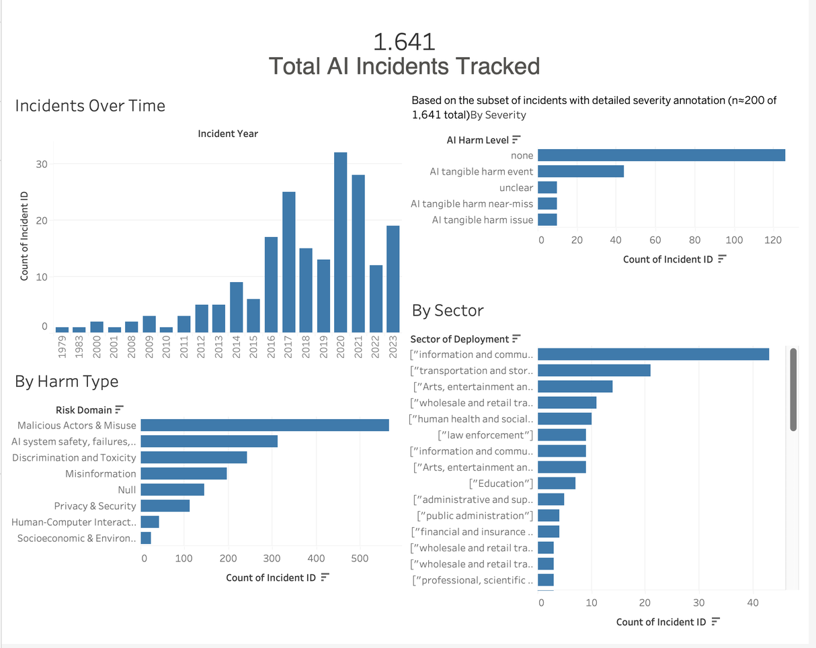
Round 1 Evidence:
The Data Landscape
QUANTIFYING AI RISKS
Analyzed 1,641 documented AI incidents
Developed a risk landscape dashboard
Identified real-world failure patterns
Based decisions on evidence, not assumptions
Established a foundation for future solutions
Tableau

Slide 4
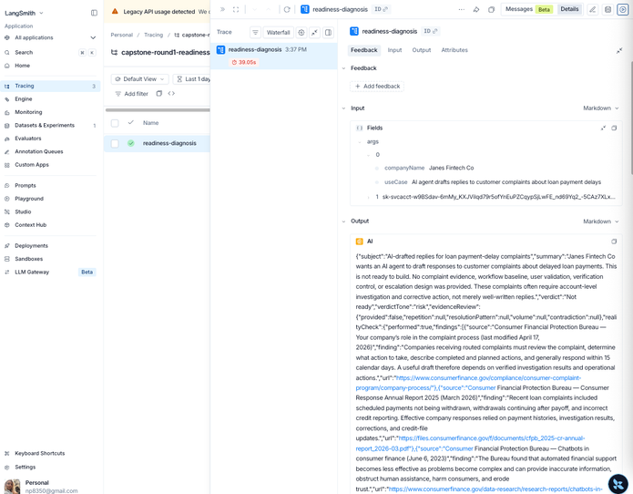
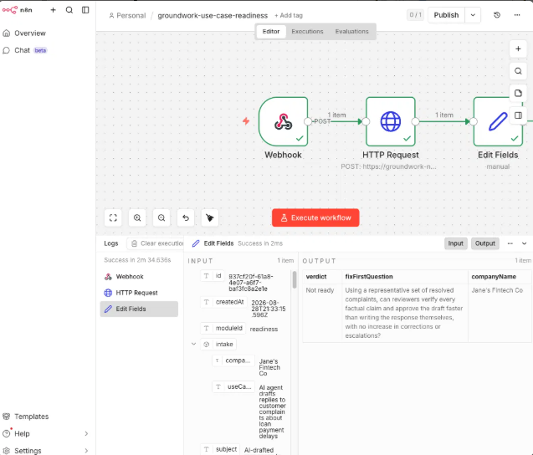
The Pipeline
Langsmith
PROOF OF CONCEPT VALIDATION
We successfully built an automation pipeline connecting a live diagnostic engine to real workflow tools, confirming technical viability before scaling for broader use.
n8n

Slide 5

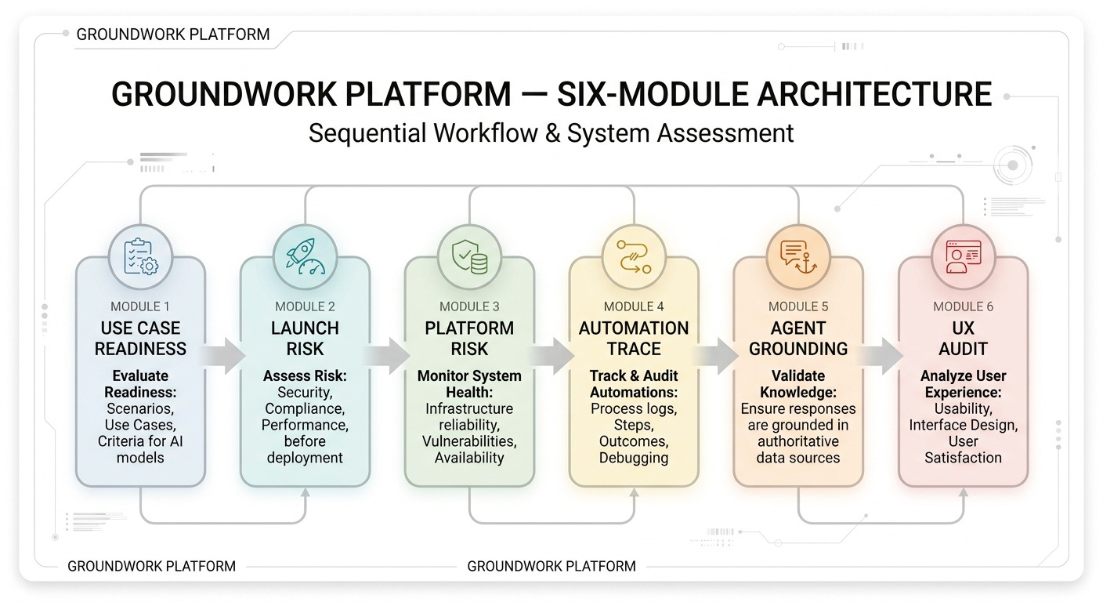
Introducing Groundwork:
AI Readiness Platform
COMPREHENSIVE AI DIAGNOSTICS
Groundwork provides a structured platform for consulting teams to assess AI readiness, ensuring decisions are founded on strong, evidence-based insights.

Slide 6
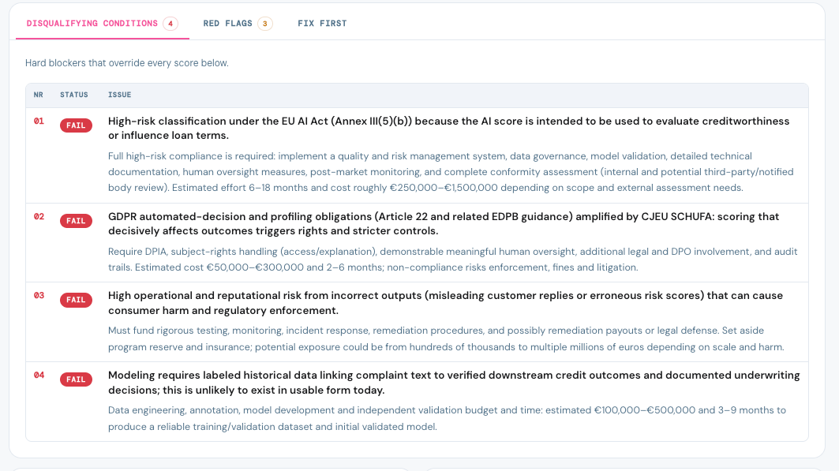
CAPABILITY ONE
Compliance By Default
AUTOMATIC LEGAL FRAMEWORKS
Every diagnosis applies the correct legal framework.
Real-time checks against EU AI Act rules.
Compliance gaps identified explicitly.
Live automated enforcement of compliance reasoning.

Slide 7
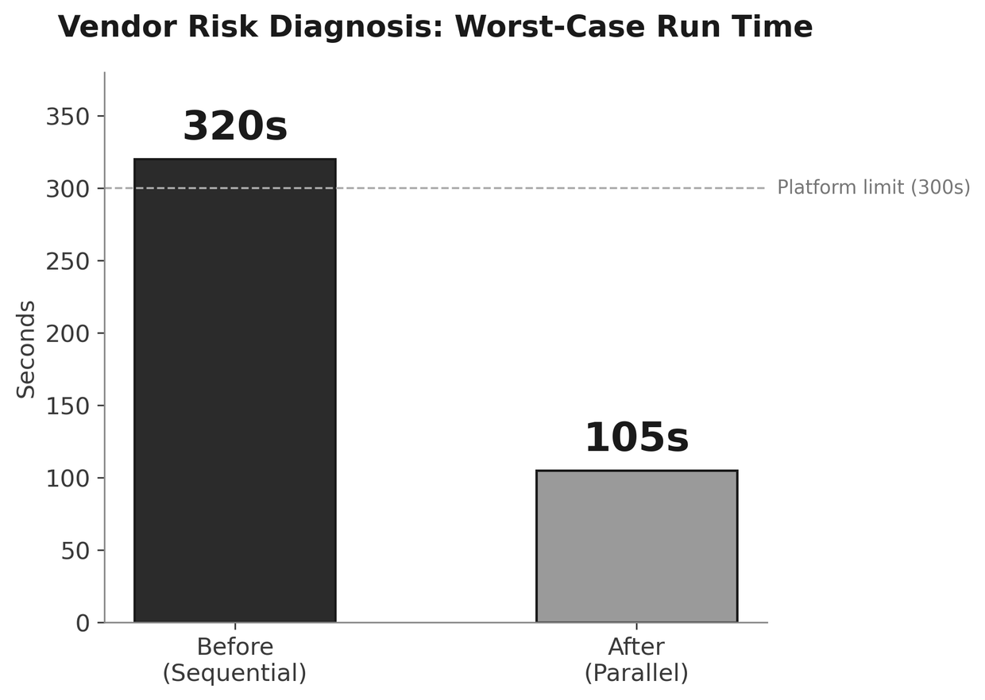
CAPABILITY TWO:
Reliable At Scale
STREAMLINED VENDOR RISK EVALUATION PROCESS
Vendor assessments completed in under two minutes
Re-engineered scoring pipeline for efficiency
Validated processes against real-life vendor data
Comprehensive reports generated end to end
Demonstrated reliability to clients on demand

Slide 8
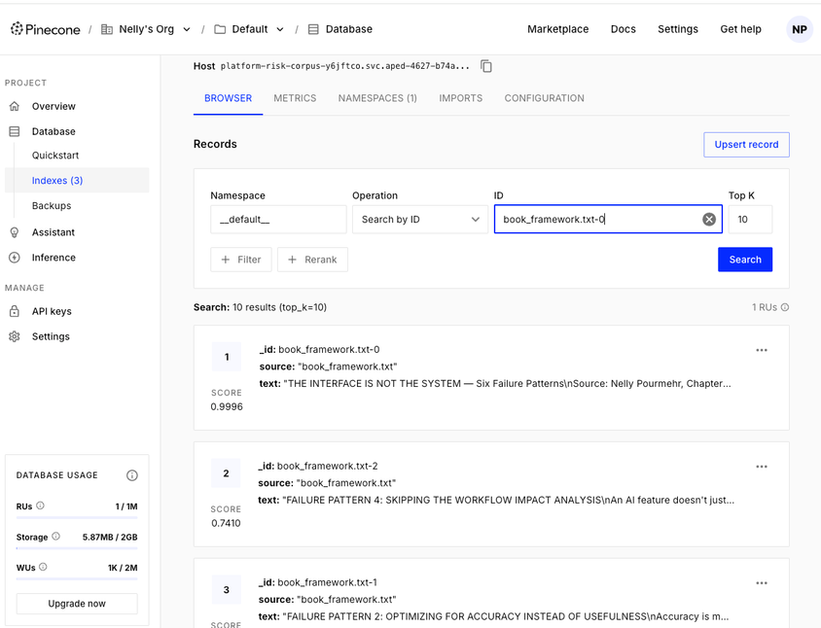
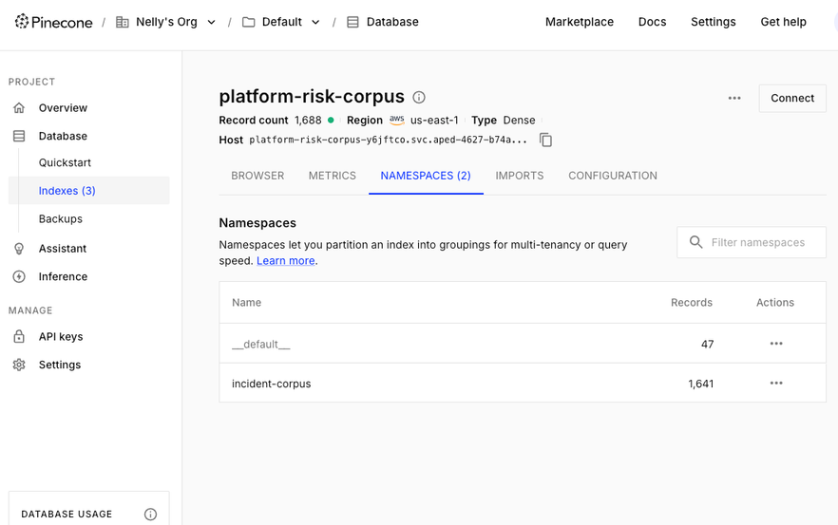
CAPABILITY THREE
Evidence-Based Risk Assessment Methodology
GROUNDED IN REAL INCIDENTS
Our risk scoring leverages 1641 documented AI incidents, transforming subjective opinions into evidence-backed findings, enhancing reliability and trust in our assessments.
Pinecone

Slide 9
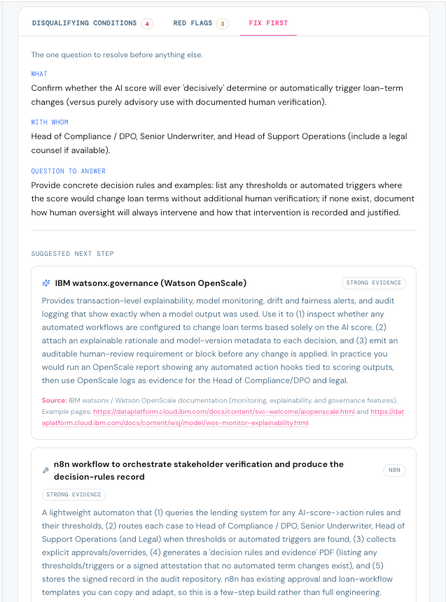
CAPABILITY FOUR
Turning Verdicts into Actionable Steps
CONCRETE NEXT STEPS
Our system generates clear, actionable recommendations after each diagnosis, allowing clients to implement changes immediately rather than waiting for further development.

Slide 10
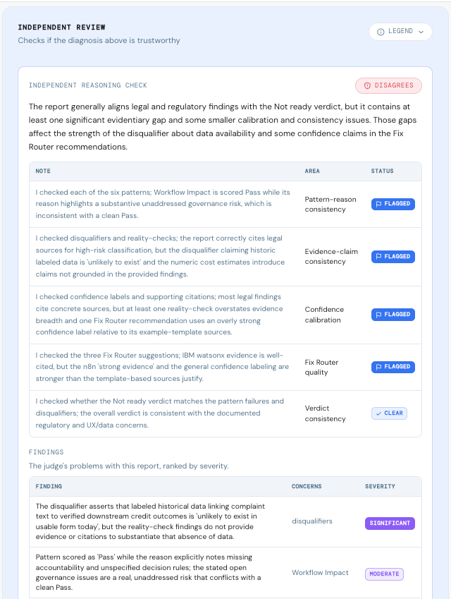
CAPABILITY FIVE
Independent Quality Assurance
ENSURING TRUSTWORTHINESS
how do you know the platform's judgment can be trusted ?
Every diagnostic reviewed by an independent AI
Checks five dimensions of reasoning quality
Catches overstated confidence and unsupported claims
Directly addresses jury's trust questions
Enhances credibility for client meetings

Slide 11
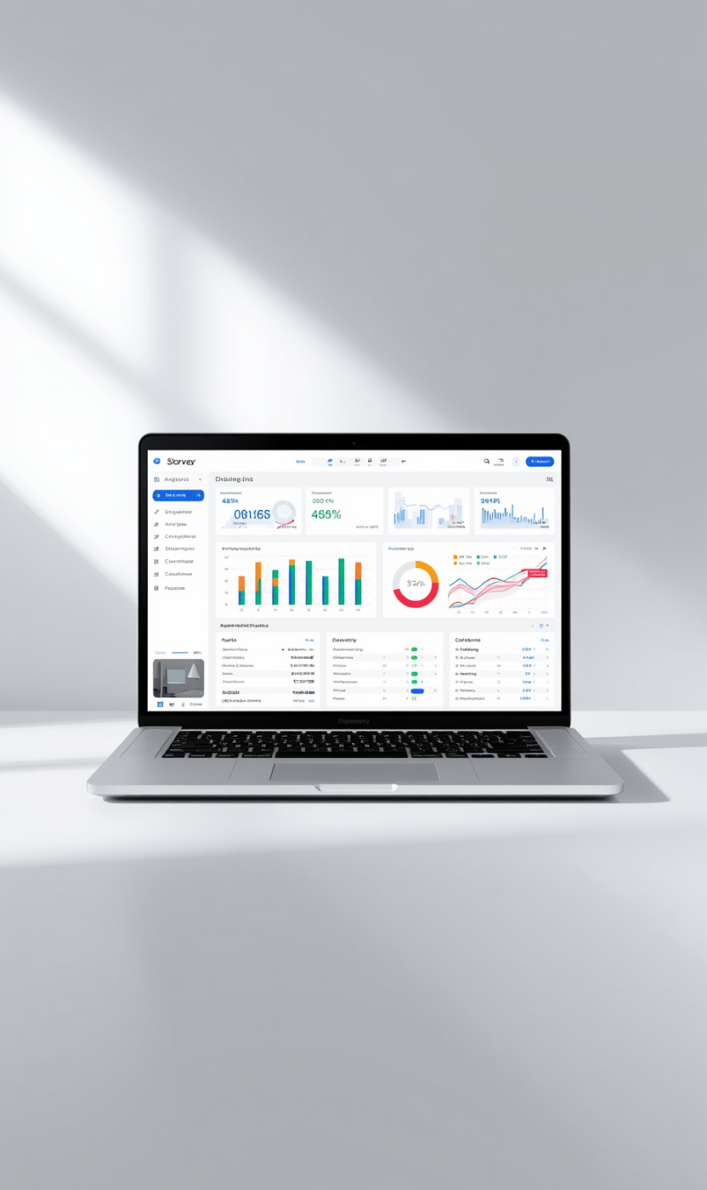

See Groundwork in Action:
Diagnostic Walkthrough
EXPERIENCE OUR PLATFORM'S CAPABILITIES
This live demonstration showcases a complete diagnostic process, illustrating real-time evidence-based verdicts and actionable insights for clients seeking AI readiness.

Slide 12
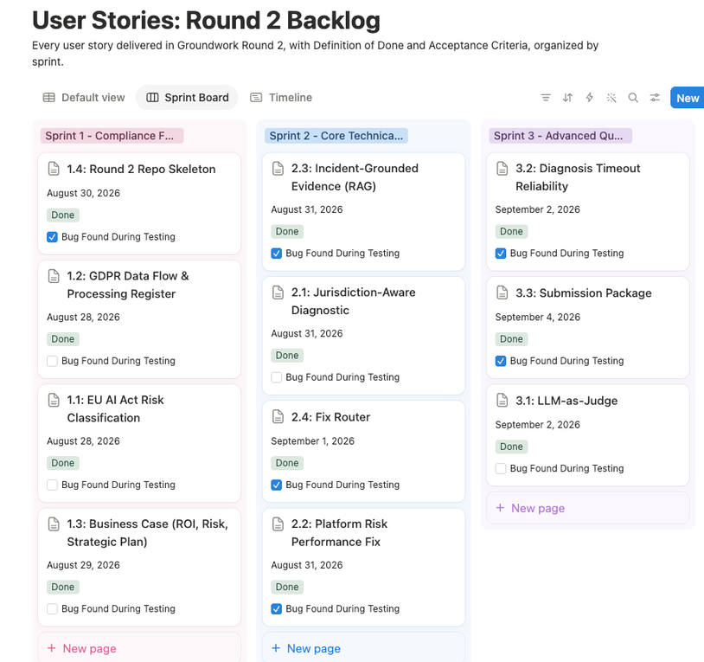
Agile Delivery Timeline
SPRINT ONE
SPRINT TWO
SPRINT THREE
Sprint 1 - Compliance Foundation
Sprint 2 - Core Technical Builds
Sprint 3 - Advanced Quality + Submission

Slide 13
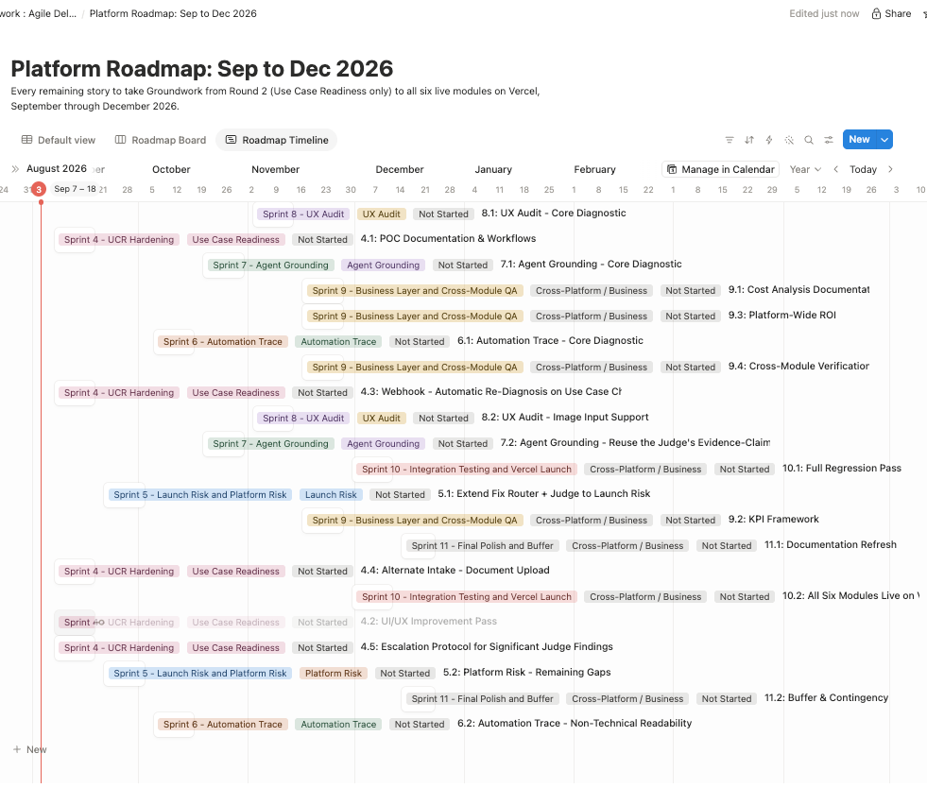
Future Development Roadmap
REMAINING MODULES
INTEGRATION TESTING
PRODUCTION LAUNCH
CONTINUOUS IMPROVEMENT
INITIAL MODULE
Finalize workflows and improve intake methods.
Complete two partial modules and start three new.
Conduct full testing across all six modules.
Deploy complete platform with real user scenarios.
Gather feedback for ongoing enhancements and updates.
Eight+ sprints Planned

Slide 14
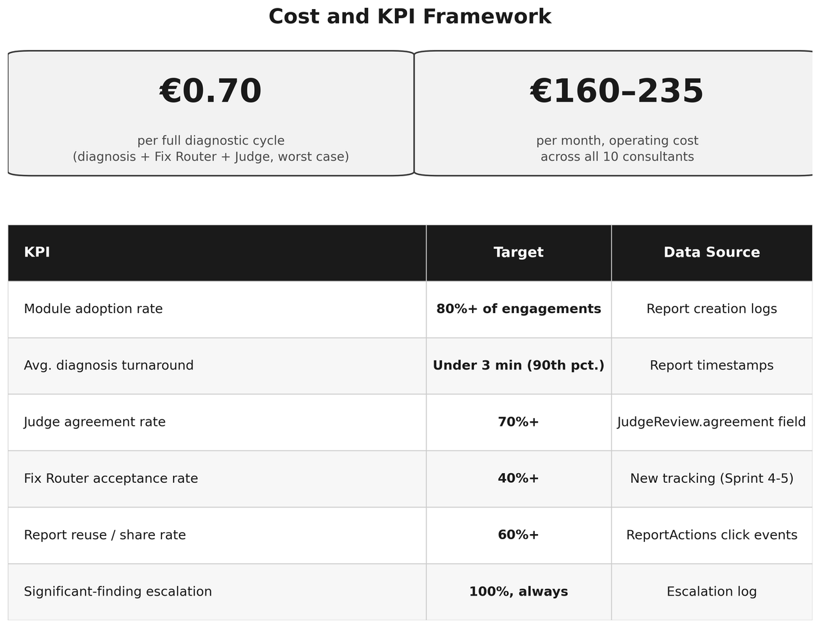
Cost and KPIs Overview
KEY METRICS FOR MEASURING SUCCESS
Operating cost under €0.25 per cycle
Monthly platform cost below €250
Six defined KPIs for tracking
Targets for adoption and efficiency
Data sources for each KPI

Slide 15
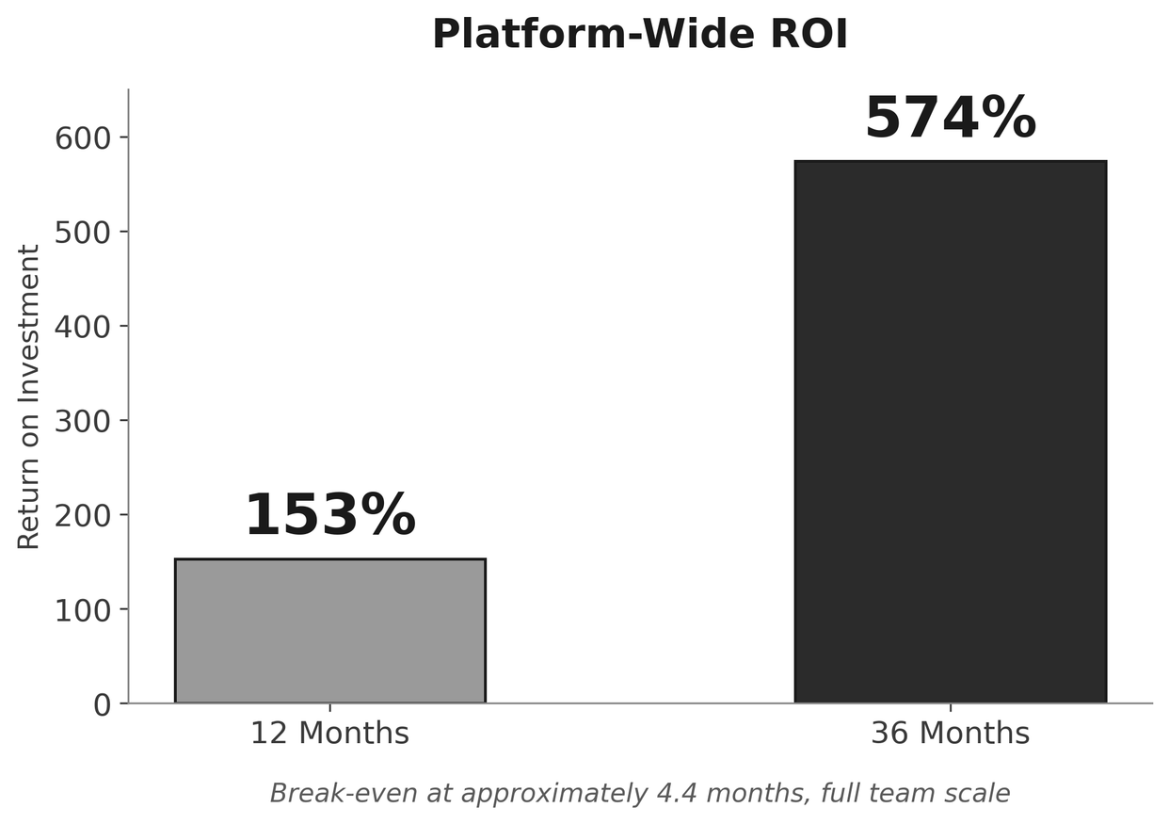
Return on Investment Overview
PROJECTED FINANCIAL GAINS
153% ROI at twelve months
574% ROI at thirty-six months
Break-even in approximately 4.5 months
Based on transparent assumptions
Significant time savings per engagement

Slide 16


Thank You for Your Attention
EMAIL ADDRESS
Pourmehr.nelly@gmail.com
SOCIAL MEDIA
@uxandai
PHONE
01736118167

